Slide 1
Al Mayadin Article Scraper & Visualization Project
Web Scraping, Data Processing, and Visualization
Mohamad Monzer
20-8-2024

Slide 2
To scrape, process, store, and visualize articles from the Al Mayadin website.
Key Components:
Web Scraping
Data Storage (MongoDB/JSON)
Data Aggregation
Visualization using Flask

Slide 3
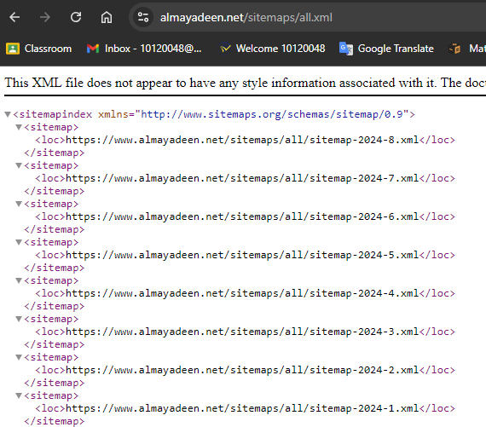
Fetching Monthly Sitemaps
Start by accessing the main sitemap index: sitemap_index_url = "https://www.almayadeen.net/sitemaps/all.xml"
This sitemap index contains URLs for each monthly
sitemap.

Slide 4
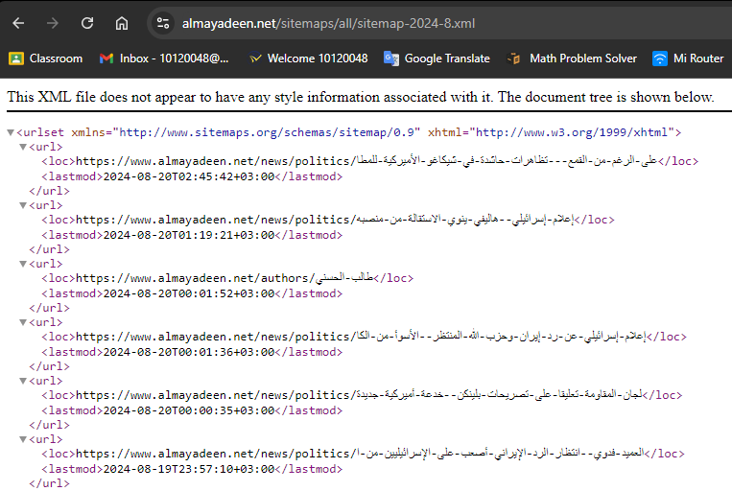
Extracting Article URLs
Parse the monthly sitemap URLs, for example: https://www.almayadeen.net/sitemaps/all/sitemap-2024-8.xml
Each monthly sitemap contains URLs
for articles
published each day/hour.
Collect all article URLs for further processin

Slide 5
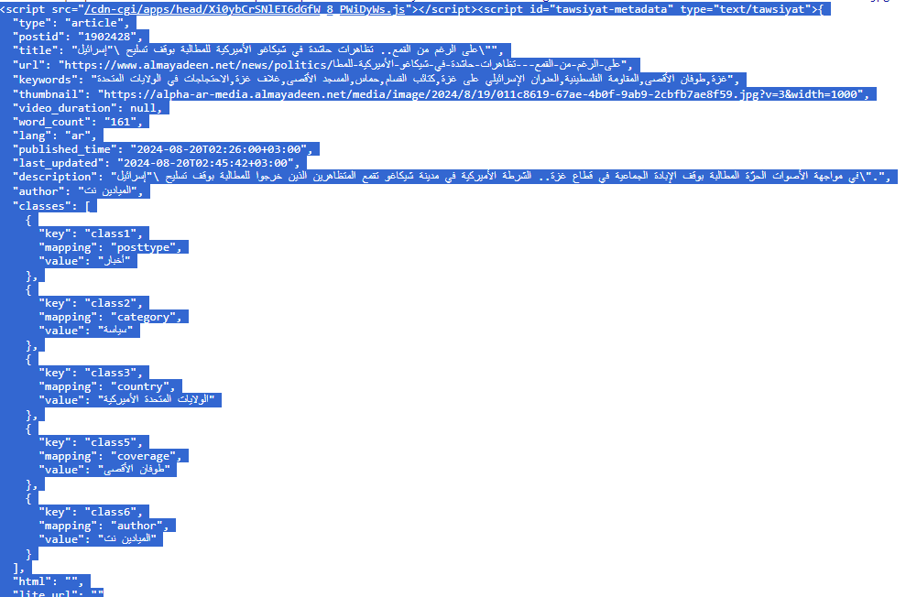
Scraping Article Content
For each article URL, extract metadata (title, author, publication date) and content. This data is then either stored directly into MongoDB or saved as JSON files.

Slide 6
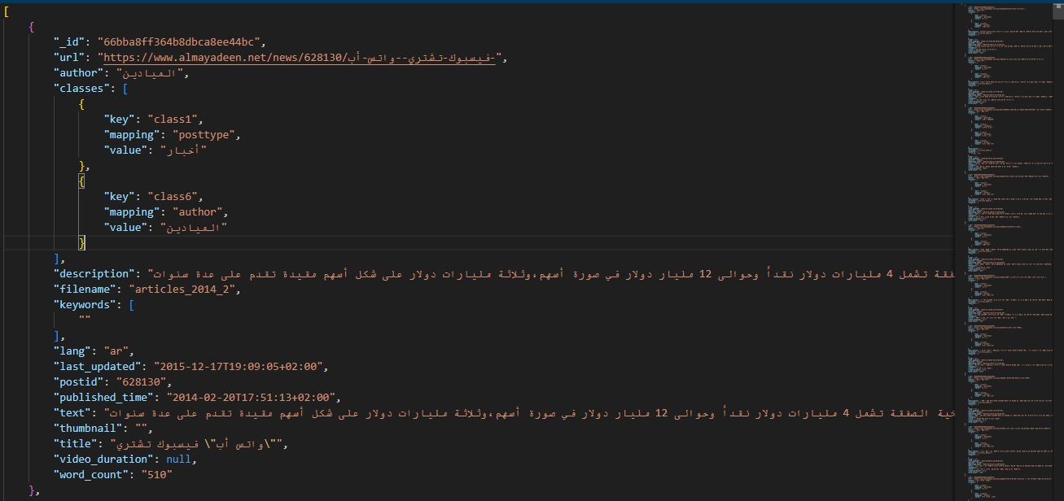
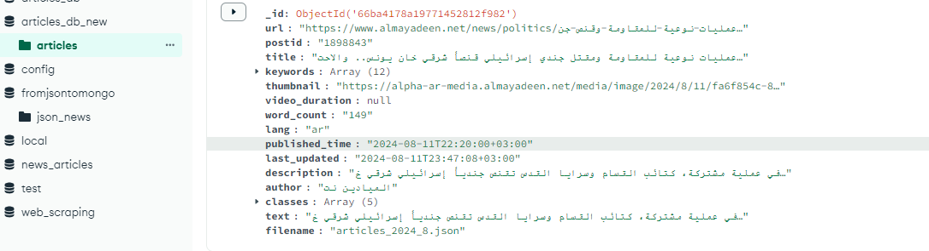
Storing Article Data
Description:
Option 1: Store data directly in MongoDB.
Option 2: Store data in JSON files.
These two options allow flexibility in how the data is processed and accessed.

Slide 7
Converting Data Between MongoDB and JSON
Description:
Convert data from MongoDB to JSON for easy sharing or backup.(mongo_data_extractor_year_month.py)
Convert JSON files back into MongoDB if needed.(data_storage.py)

Slide 8
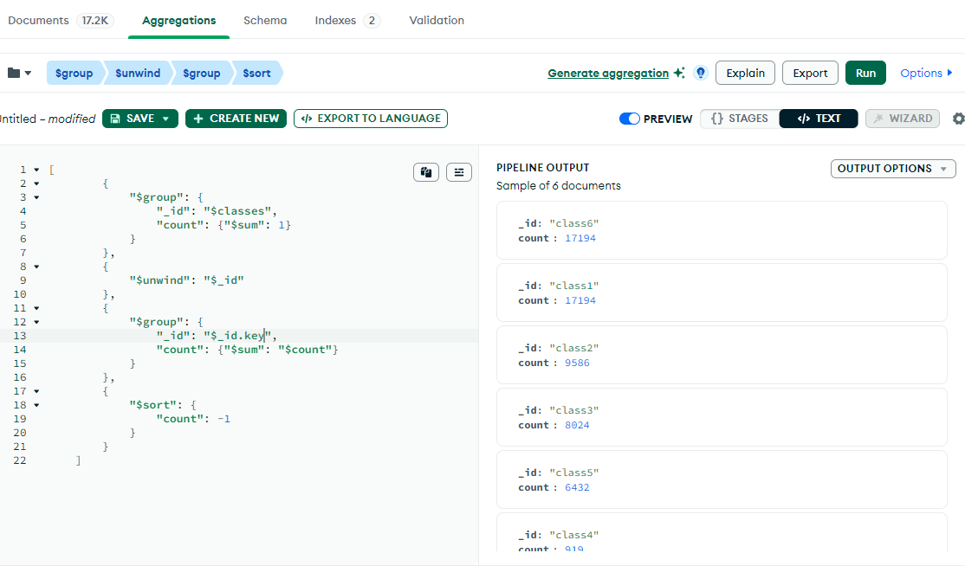
Aggregating Data with MongoDB Compass
Description: Use MongoDB Compass to perform data aggregation, filtering, and analysis.

Slide 9
Visualizing Data with Flask
Description:
Flask is used to create a web interface that displays visualizations.
Example visualizations: Keyword frequency graphs, article trends over time.
The Flask app reads data from MongoDB or pre-generated JSON files.

Slide 10
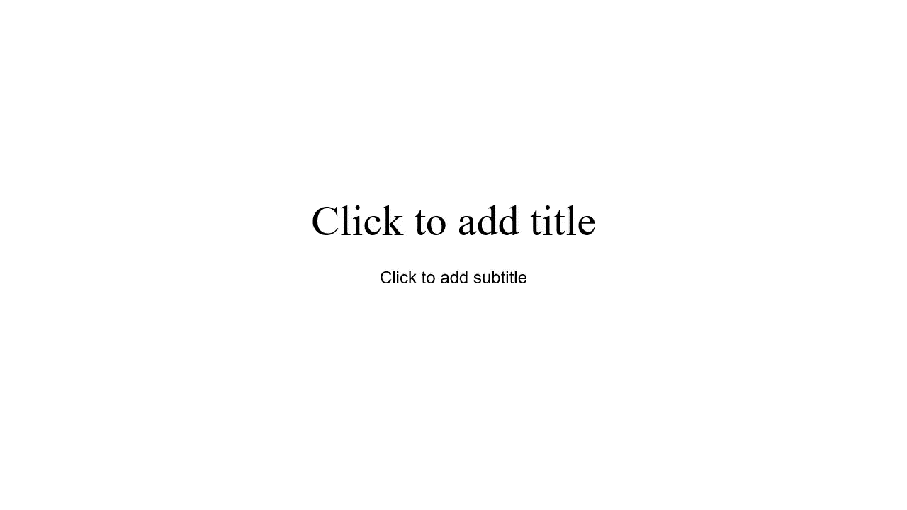

Slide 11
Conclusion
Summary:
Successfully scraped, processed, and stored article data.
Demonstrated flexibility in data storage options (MongoDB/JSON).
Utilized Flask for interactive data visualization.
Future Work: Potential improvements or future enhancements:
Real-time data updates
More advanced visualizations

